Slide 1
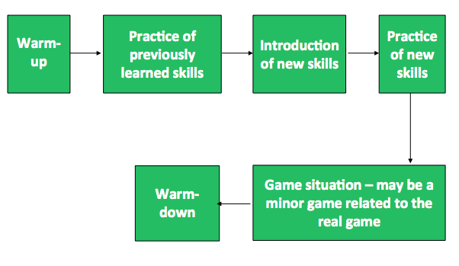
Traditional Approach to PE Teaching

Slide 2
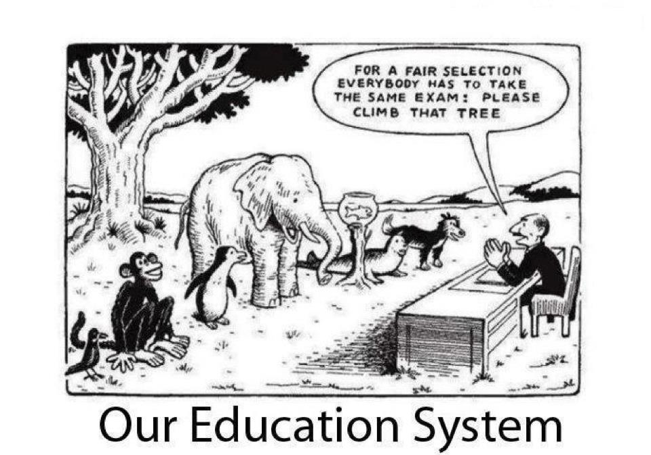
Pedagogy is not a one size fits all

Slide 3
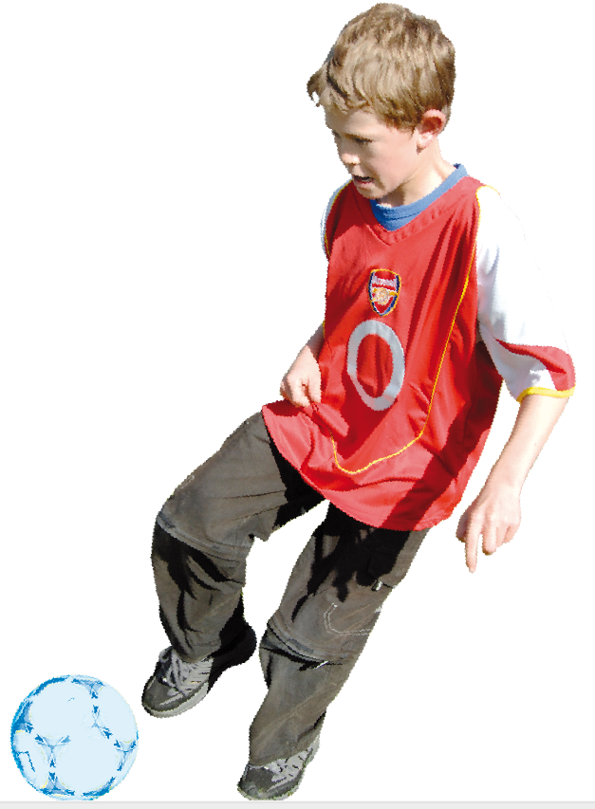
Types of Learners
Visual learners | love you to show them how to do it
Auditory learners | like to listen to instructions and messages
Kinaesthetic learners | like to try the activity or the skill

Slide 4
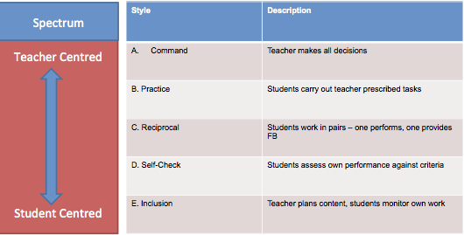
Spectrum of Teaching Styles
A-E → Knowledge reproduction cluster → standardised ways, no choice for students
http://www.spectrumofteachingstyles.org/

Slide 5
Strengths & Weaknesses
Strengths of Command & Practice Styles | Weaknesses of Command & Practice Styles
Knowing teacher’s expectations | Copying not understanding
Seeing what to do | Stopping & starting
Time effective – getting to the point quickly | Lower participation/ less huffing and puffing
Errors minimised | No self-correction enabled
Clear instructions | Less engaging for students – being “told”
May suit students who expect to be told what to do – their learning style | Is dependent on prior knowledge
Allows students to watch first | Teaching important tactics without “thinking” about the tactic

Slide 6
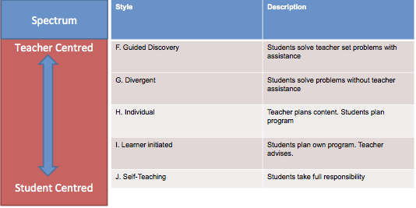
Spectrum of Teaching Styles
F-J → Knowledge production cluster → construction, creation, discover – more choice for students

Slide 7

Inquiry-based Approach
Inquiry-based coaching focuses on teachers/coaches asking questions and creating curiosity for answers in athletes.

Slide 8

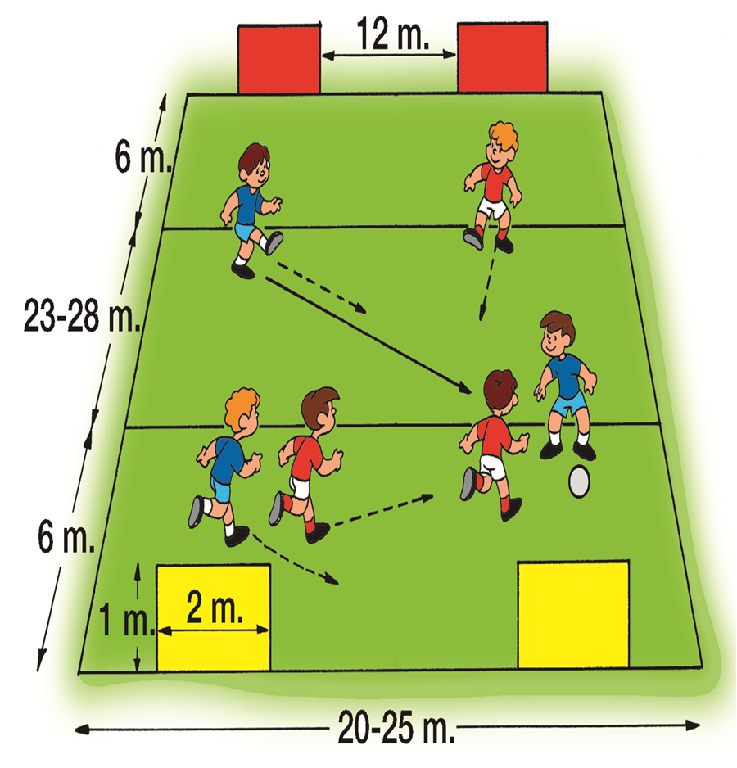
What is Game Sense?
Game Sense is a teaching approach that is based upon the Teaching Games for Understanding Model. (Light, R, 2006)
It is based upon the individuals ability to develop sport and physical ability skills through game-centred activities which are designed to improve a person’s decision making, thinking and problem-solving skills and physical performance in an interactive environment. (Mandigo, Butler & Hopper, 2007)
While skill is an important element of Game Sense, it is developed contextually by participating in modified games. Students develop an understanding of the game by thinking and communicating about both the tactics and technique of the game. (Light, R, 2006)

Slide 9


Teaching Games for Understanding (TGfU)
A method for effective teaching/coaching.
TGfU model was developed during the 1970’s and early 1980’s from the work of Thorpe and Bunker.
A game-centred model that focuses on a more athlete-centred approach that explores tactics and skills in a game context.

Slide 10
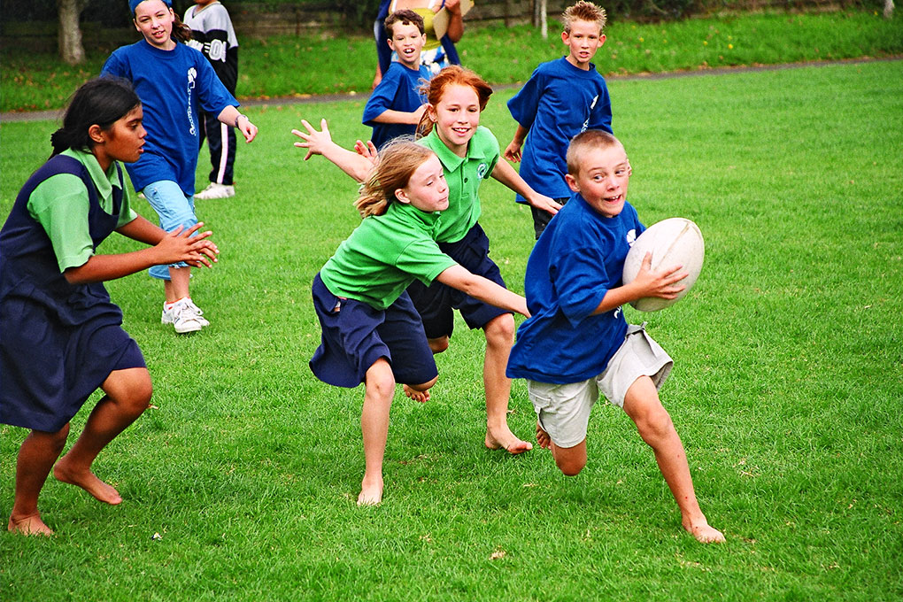
Why Game Sense?
Traditional coaching focuses on the isolation of skill development and ultimately lessens children’s ability to be motivated to learn and enjoy physical activity.
In comparison, Game Sense provides children with the opportunity to learn about technique and skills through a contextually modified game that is appropriate to age and ability.
Therefore, the skills are learnt in a fun and enjoyable way, whilst children are also gaining an understanding of the game’s format and rules.

Slide 11
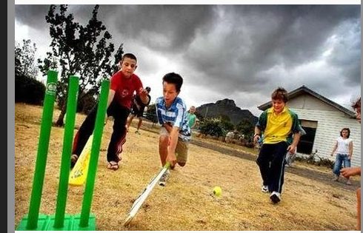
Game Sense Benefits
Game Sense guides children to develop the ability to express themselves, gain socialisation skills through interaction with peers, and helps them to learn how to solve problems and conflicts.
Game Sense caters for students of all different ages, sizes, abilities and interests.
Game Sense provides teacher or coaches with more flexibility. Modifications made to games, accommodates students of all different skill levels and ensures that the game is still enjoyable for everyone.

Slide 12
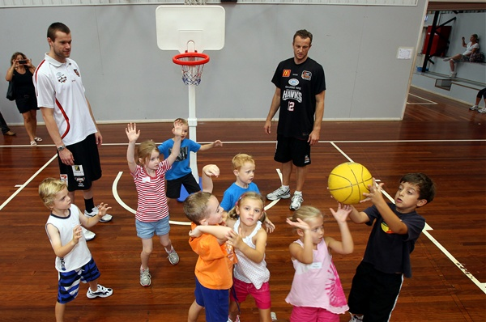
Games Approach to Teaching
Games are a powerful coaching tool for teaching strategies and skills in sport.
It is more holistic.
Game understanding is integrated with the learning of techniques and tactics.
It focuses on a ‘doing’ approach where athletes experience and learn by trying things in a game-like context.

Slide 13
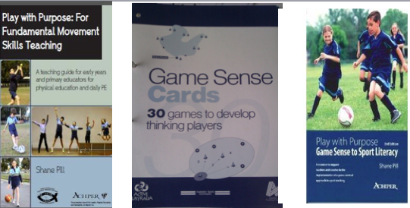
Game Sense teaching/coaching looks different at different stages of player development, but the “pedagogical toolkit” and focus on “guided discovery” learning of technical and tactical skill remains.

Slide 14
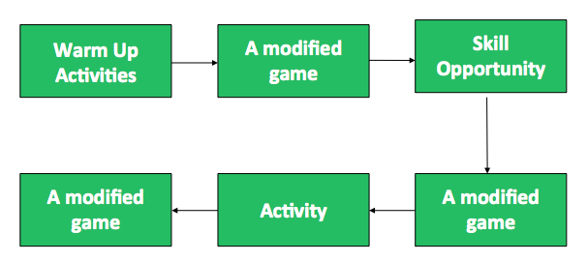
A Games Approach Session
The following chart shows the flow in a coaching session that is a games approach (TGfU) based

Slide 15
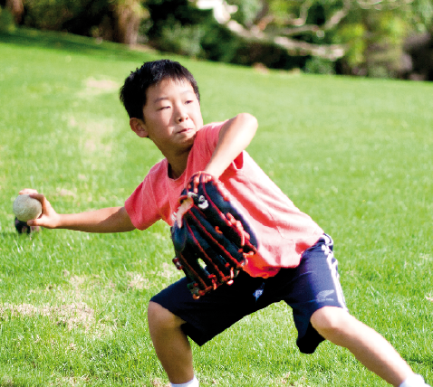
When Teaching Games for Understanding
focus on the WHY first and the HOW after
by focusing on one or two aspects of the actual game we allow an opportunity to practice aspects that need improvement

Slide 16
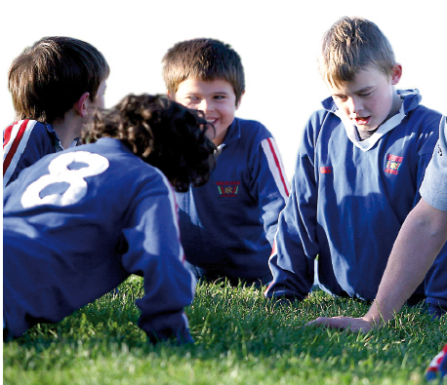
TGfU
Games can be modified by manipulating rules, space and equipment
This makes aspects easier or more difficult therefore enhancing game understanding and performance.

Slide 17
The TGFU Model
Game: A modified game creates an understanding of the games objective, concepts and skills.
Game Appreciation: Students develop an appreciation for the games rules, skills and strategies.
Tactical Awareness: Students learn how to use offensive and defensive tactics to their advantage.
Decision Making: Students develop the ability to make appropriate decisions.
Skill Execution: Students begin to understand the importance of properly executed technique and skills.
Game Performance: Involves applying previous steps in a proper game. (Mandigo, Butler & Hopper, 2007)

Slide 18

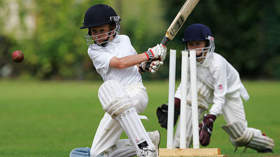


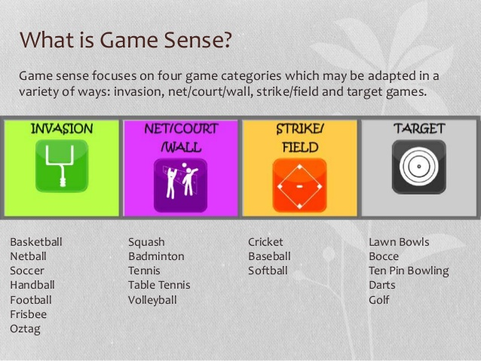
TGfU Categories
The games in a TGfU model are organised into four categories which may be adapted in a variety of ways:

Slide 19
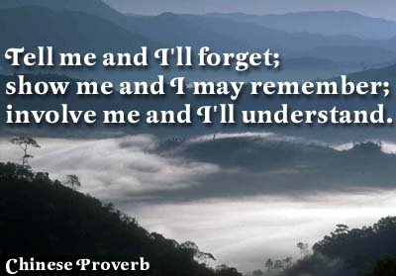
Some concluding quotes…..
“The traditional objectives of developing fundamental movement and sport skills still exist. However, there is an ever-pressing need to ensure that skills across a number of activities are developed in order to help children and youths develop a repertoire of skills in order to become physically literate” (Mandigo & Corlett, 2005, p. 70).
“Sport and physical education are ideal tools to also teach life skills such as respect, inclusion, cooperation, and teamwork, and metacognitive skills such as problem solving, critical thinking and goal setting. These skills will result not only in better movers within sport and PE. But also in healthier and more successful society” (Mandigo & Corlett, 2005, p. 70).

Slide 20
References & Resources
Griffin, L. L., & Butler, J. I. (2005). Teaching games for understanding. Theory, research and practice. Champaign, IL: Human Kinetics.
Light, R. (2006). Game Sense: Innovation or just good coaching? Journal of Physical Education New Zealand, 39 (1), 8-19.
Mandigo, J., Butler., & Hopper, T. (2007) What is teaching games for understanding? A Canadian Perspective. Physical & Health Education Journal, 73 (2), 14-20.
Mandigo, J., & Corlett, J. (2005). Teaching games for an understanding of what? TGfU’s role in the development of physical literacy (p. 70 ). In L. L. Griffin, & J. I. Butler (Eds.), Teaching games for understanding. Theory, research and practice. Champaign, IL: Human Kinetics.
Mosston, M., & Ashworth, S. (2008). Teaching physical education (1st online edition). Retrieved from http://www.spectrumofteachingstyles.org/pdfs/ebook/Teaching_Physical_Edu_1st_Online_old.pdf
If you want to learn more about Game Sense, just follow these links:
http://www.ausport.gov.au/sportscoachmag/coaching_processes/teaching_games_for_understanding
http://tgfuinfo.weebly.com/
https://www.youtube.com/watch?v=8yiZlXZ9rd4

